Slide 1
LEARN United-Human Resources 101
David Miklas
Law Office of David Miklas, P.A.
Representing Florida Employers Since 1998
www.MiklasEmploymentLaw.com
David@MiklasEmploymentLaw.com
October 24, 2025

Slide 2



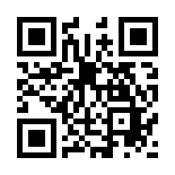

Slide 3
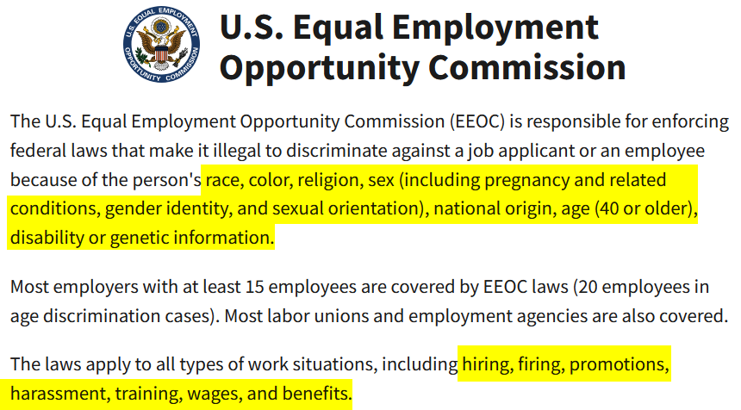

Slide 4
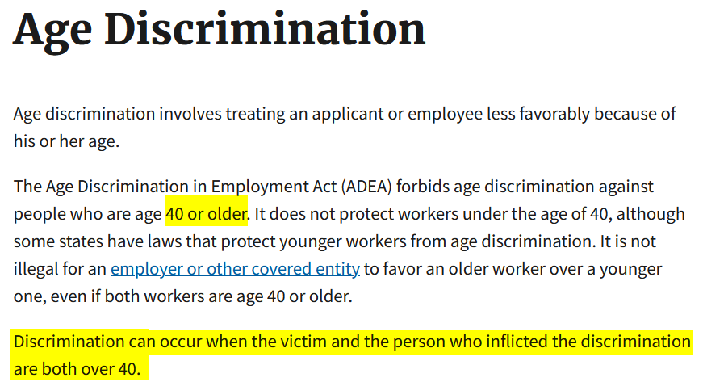

Slide 5
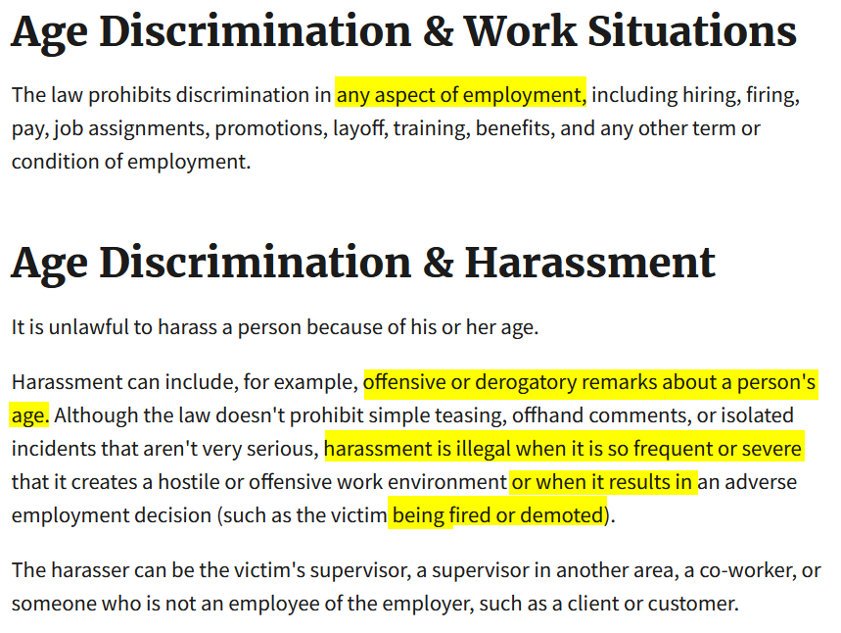

Slide 6
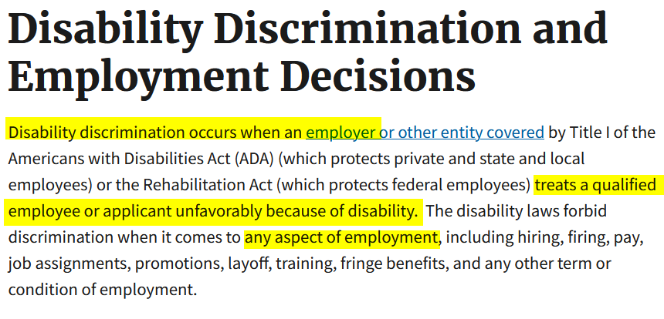

Slide 7
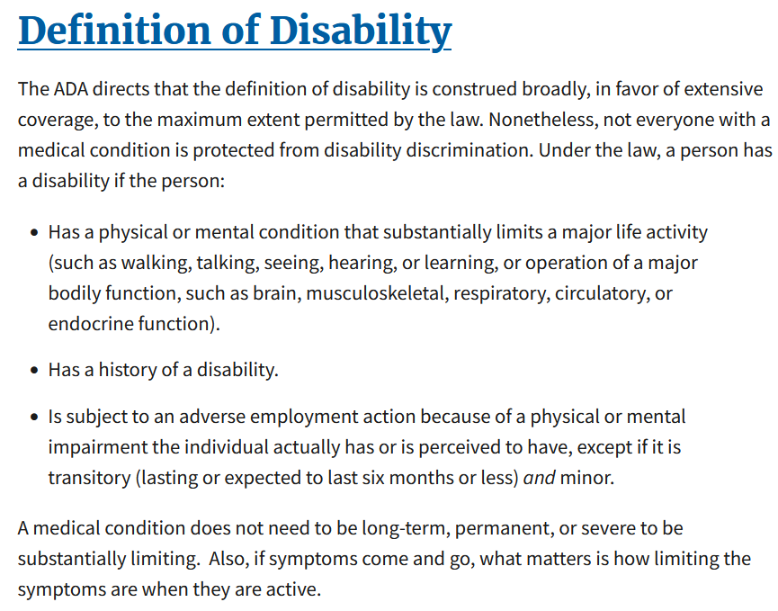

Slide 8
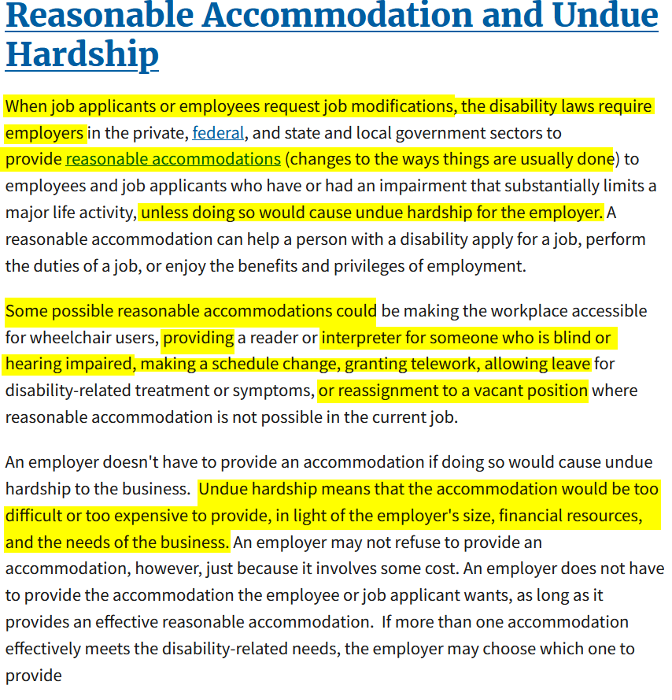

Slide 9
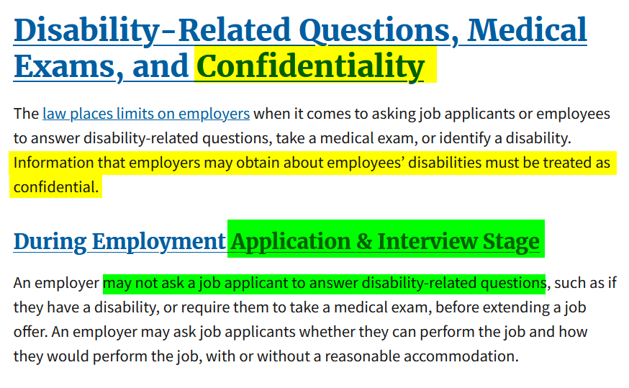

Slide 10
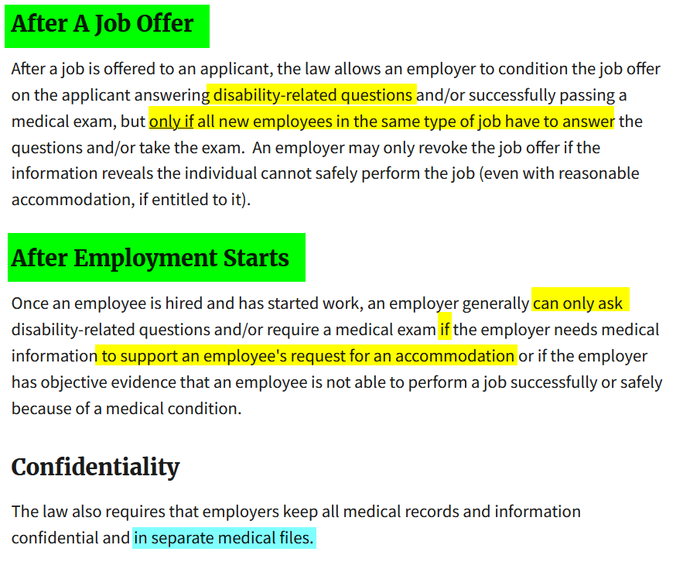

Slide 11
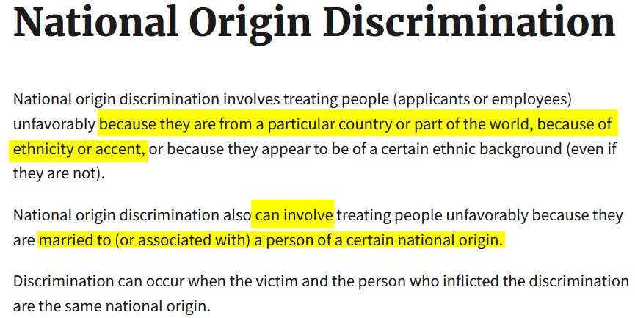

Slide 12
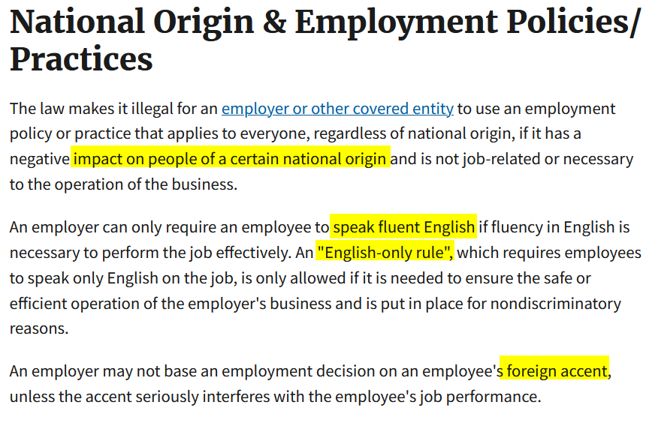

Slide 13
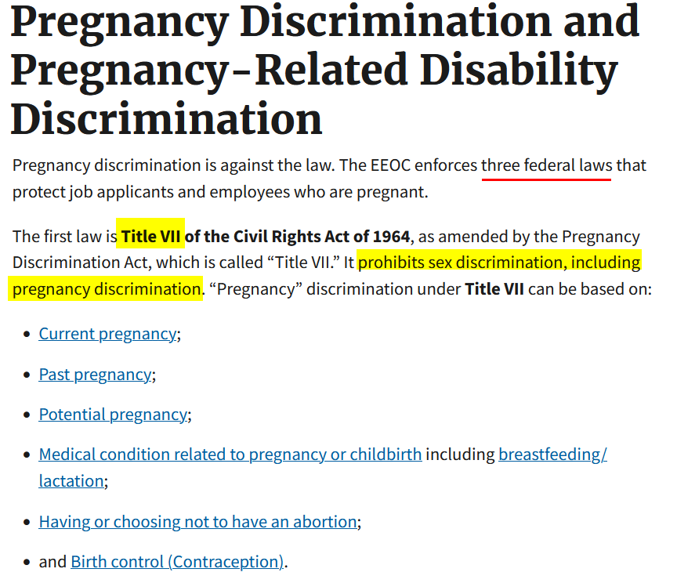

Slide 14
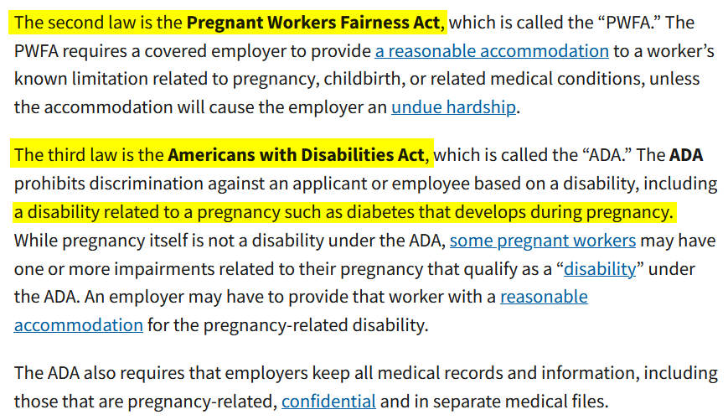

Slide 15
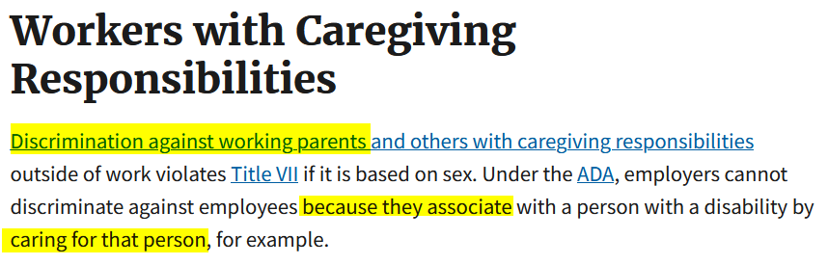

Slide 16
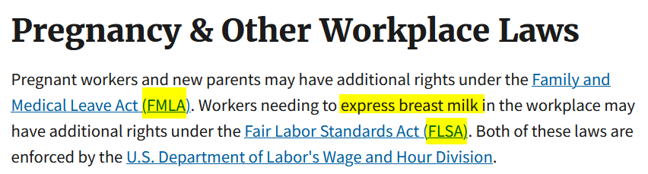

Slide 17
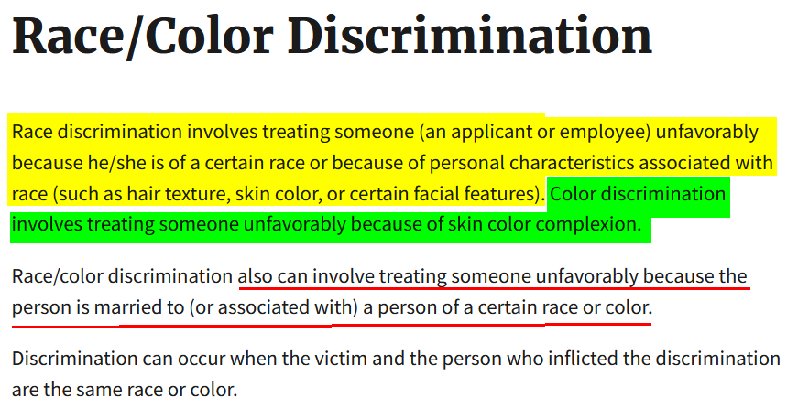

Slide 18
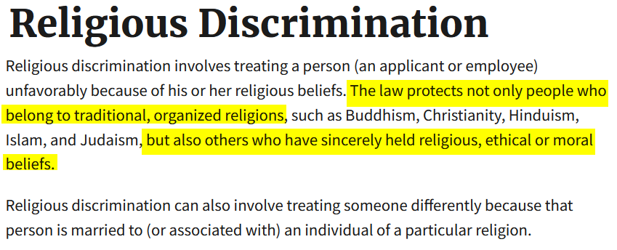

Slide 19
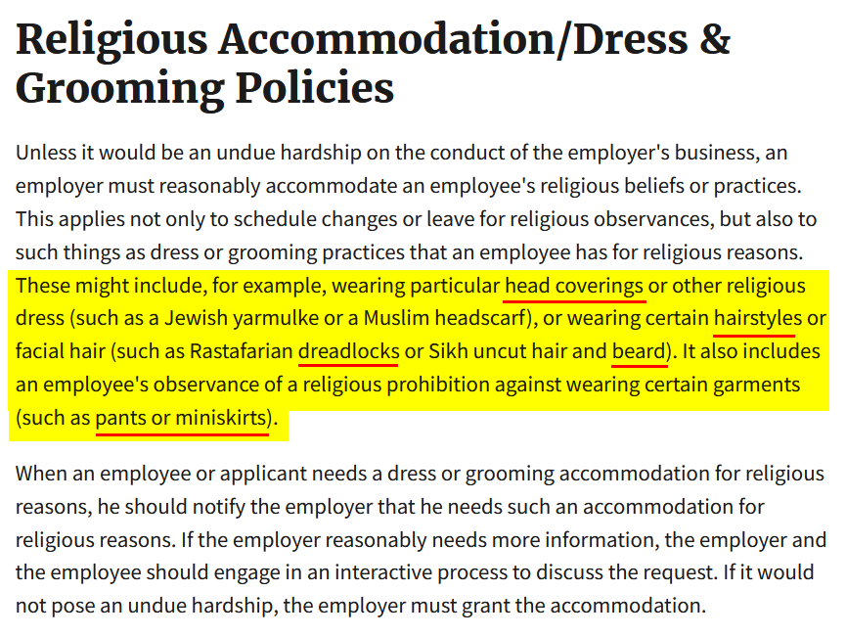

Slide 20
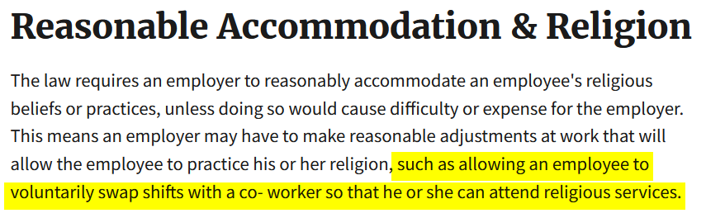

Slide 21
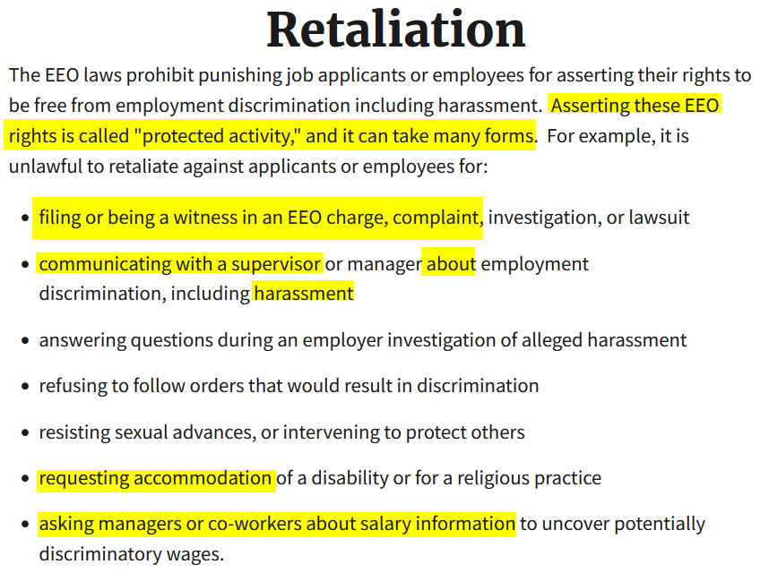

Slide 22
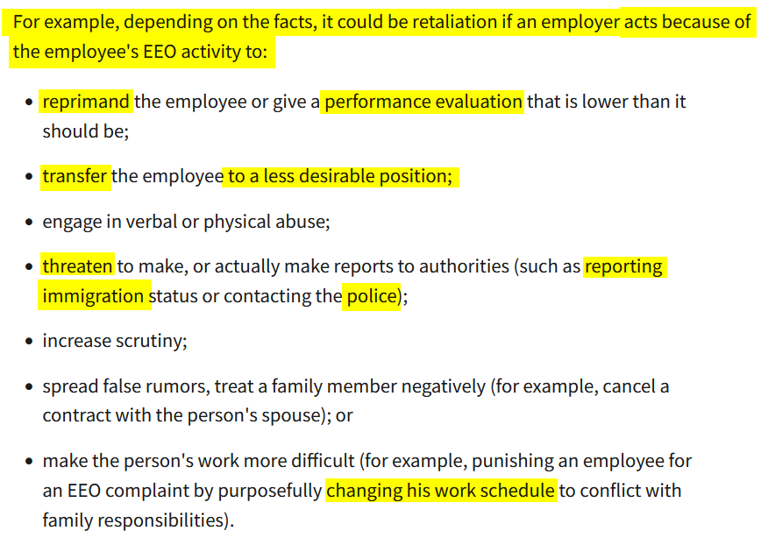

Slide 23
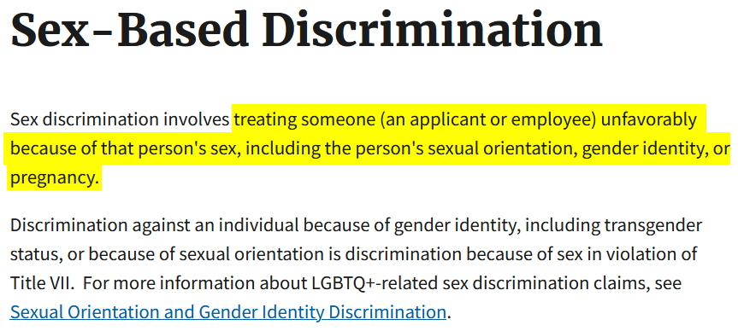

Slide 24
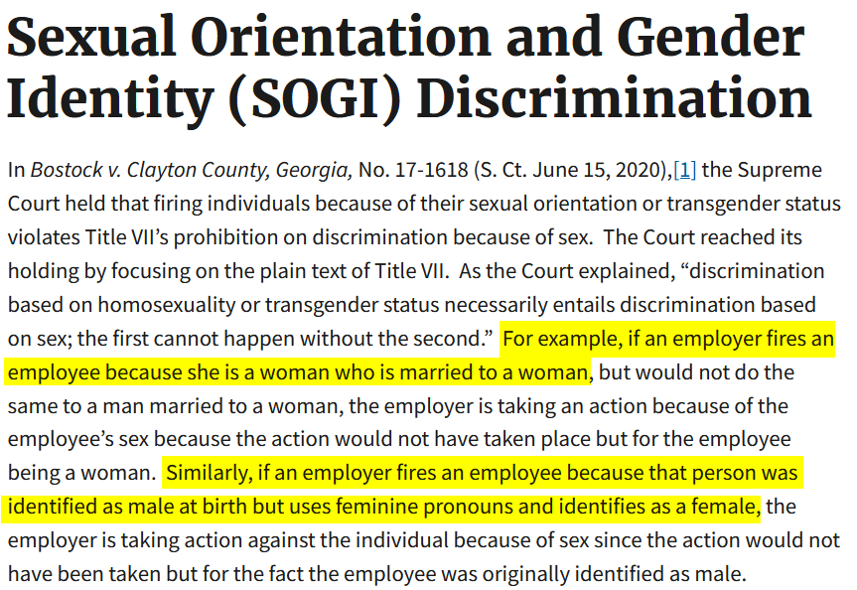

Slide 25
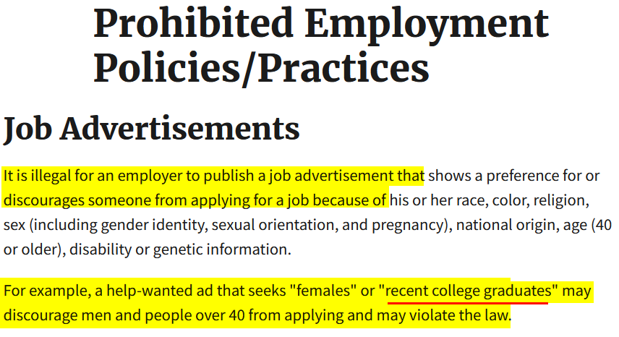

Slide 26
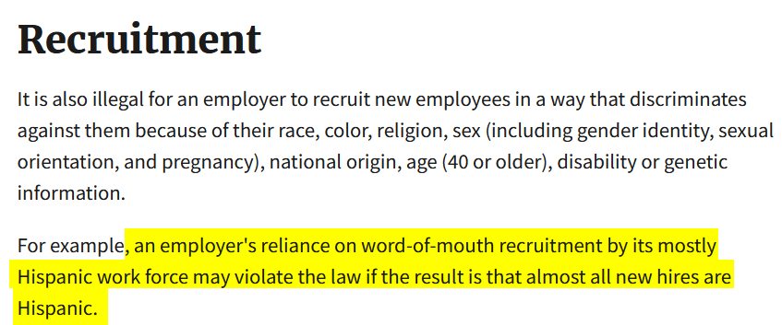

Slide 27
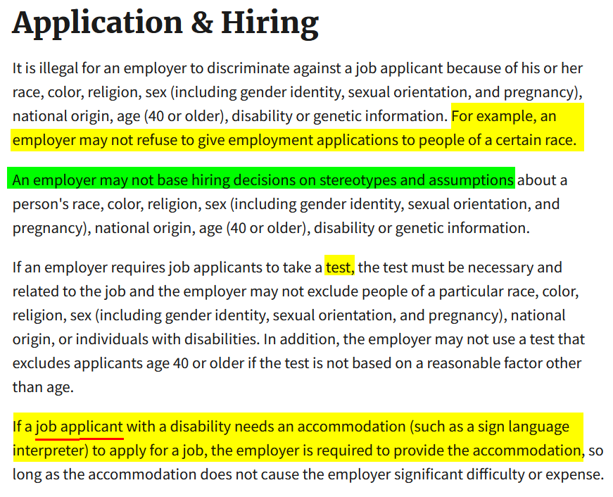

Slide 28
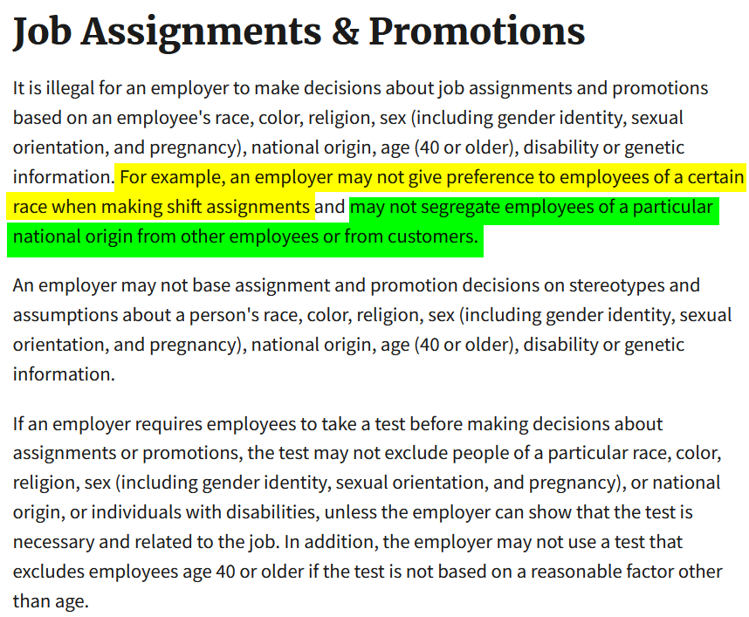

Slide 29
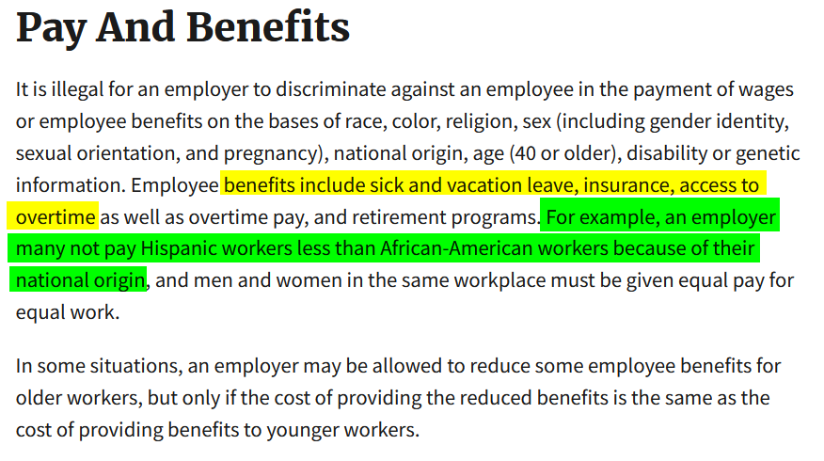

Slide 30
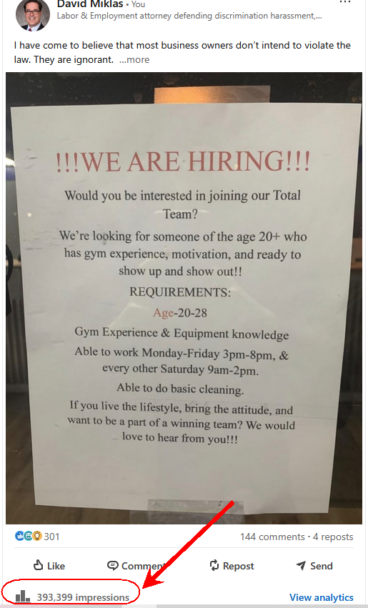

Slide 31
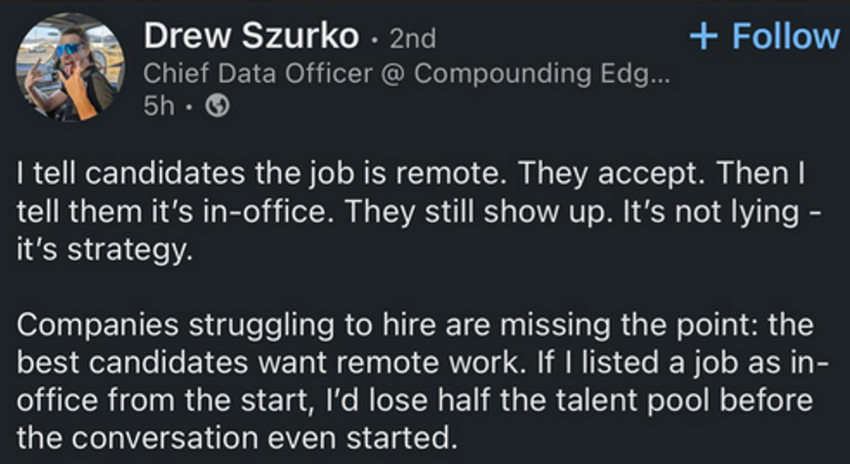

Slide 32


Slide 34


Slide 35
Keep employees engaged
Don’t ignore complaints
Show you listen and explain why you cannot do what they want (seat at the table)

Slide 36
The FLSA does not require:
vacation, holiday, severance, or sick pay;
meal or rest periods, holidays off, or vacations;
premium pay for weekend or holiday work;
pay raises or fringe benefits; or
a discharge notice, reason for discharge, or immediate payment of final wages to terminated employees.

Slide 37
Exemptions from Both Minimum Wage and Overtime Pay
Executive, administrative, and professional employees (including teachers and academic administrative personnel in elementary and secondary schools), outside sales employees, and employees in certain computer-related occupations (as defined in DOL regulations);
Employees of certain seasonal amusement or recreational establishments, employees of certain small newspapers, seamen employed on foreign vessels, employees engaged in fishing operations, and employees engaged in newspaper delivery;
Farmworkers employed by anyone who used no more than 500 “man-days” of farm labor in any calendar quarter of the preceding calendar year;
Casual babysitters and persons employed as companions to the elderly or infirm.

Slide 38
Recordkeeping
The FLSA requires employers to keep records on wages, hours, and other items, as specified in DOL recordkeeping regulations. The records do not have to be kept in any particular form and time clocks need not be used. With respect to an employee subject to the minimum wage provisions or both the minimum wage and overtime pay provisions, the following records must be kept:
personal information, including employee’s name, home address, occupation, sex, and birth date if under 19 years of age;
hour and day when workweek begins;
total hours worked each workday and each workweek;
total daily or weekly straight-time earnings;
regular hourly pay rate for any week when overtime is worked;
total overtime pay for the workweek;
deductions from or additions to wages;
total wages paid each pay period; and
date of payment and pay period covered.
Records required for exempt employees differ from those for nonexempt workers.

Slide 39
Terms Used in FLSA
Workweek - A workweek is a period of 168 hours during 7 consecutive 24-hour periods. It may begin on any day of the week and at any hour of the day established by the employer. Generally, for purposes of minimum wage and overtime payment, each workweek stands alone; there can be no averaging of 2 or more workweeks. Employee coverage, compliance with wage payment requirements, and the application of most exemptions are determined on a workweek basis.
Hours Worked - Covered employees must be paid for all hours worked in a workweek. In general, “hours worked” includes all time an employee must be on duty, or on the employer’s premises or at any other prescribed place of work, from the beginning of the first principal activity of the work day to the end of the last principal work activity of the workday. Also included is any additional time the employee is allowed (i.e., suffered or permitted) to work.

Slide 40
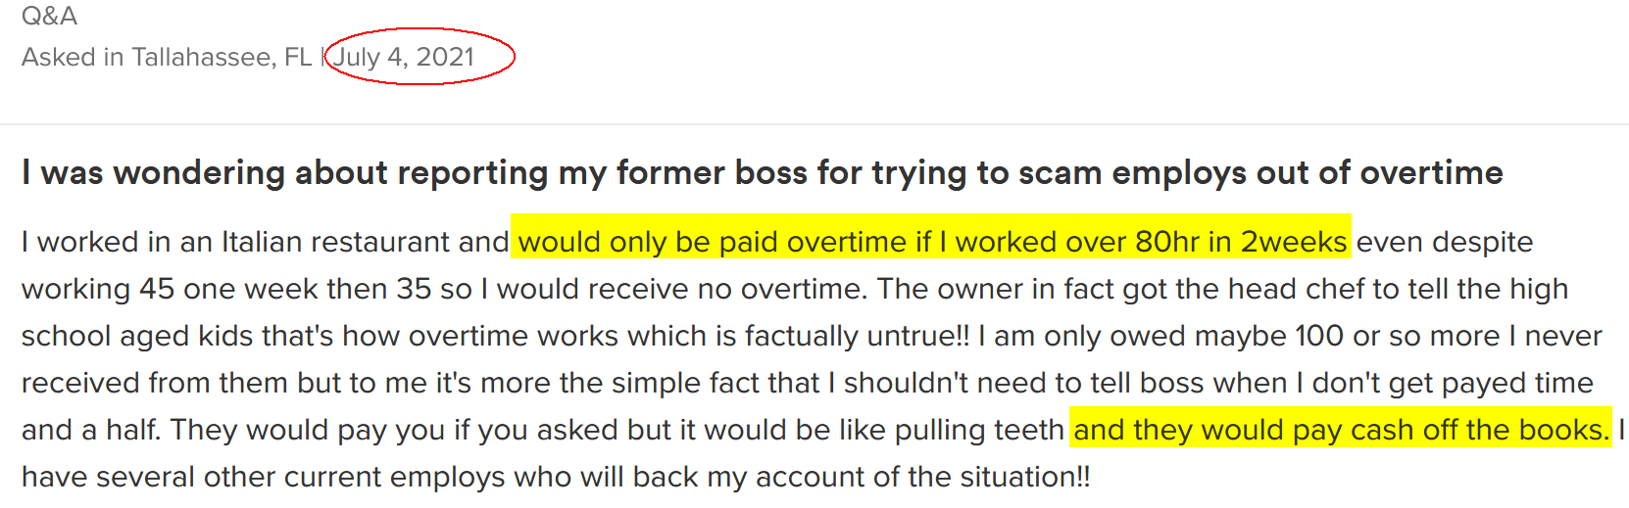

Slide 41
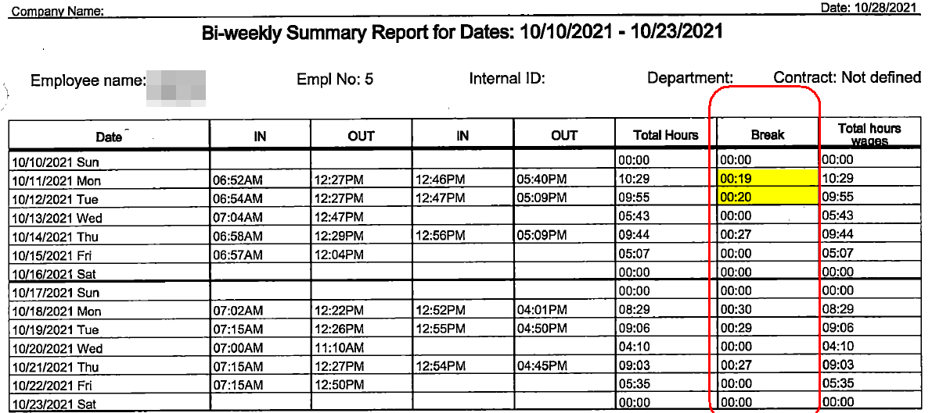

Slide 42
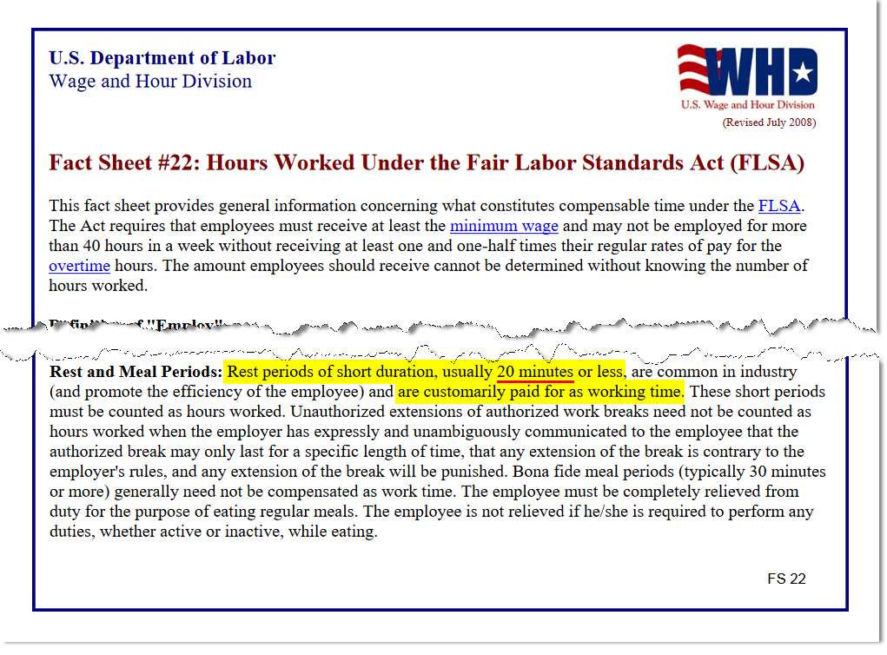

Slide 43
It is legal to not pay an employee overtime so long as the employee is paid a salary of at least $684/week (Poll)
___ True
___ False

Slide 44
It is legal to not pay an employee overtime so long as the employee is paid a salary of at least $684/week (Poll)
___ True
___ False

Slide 45
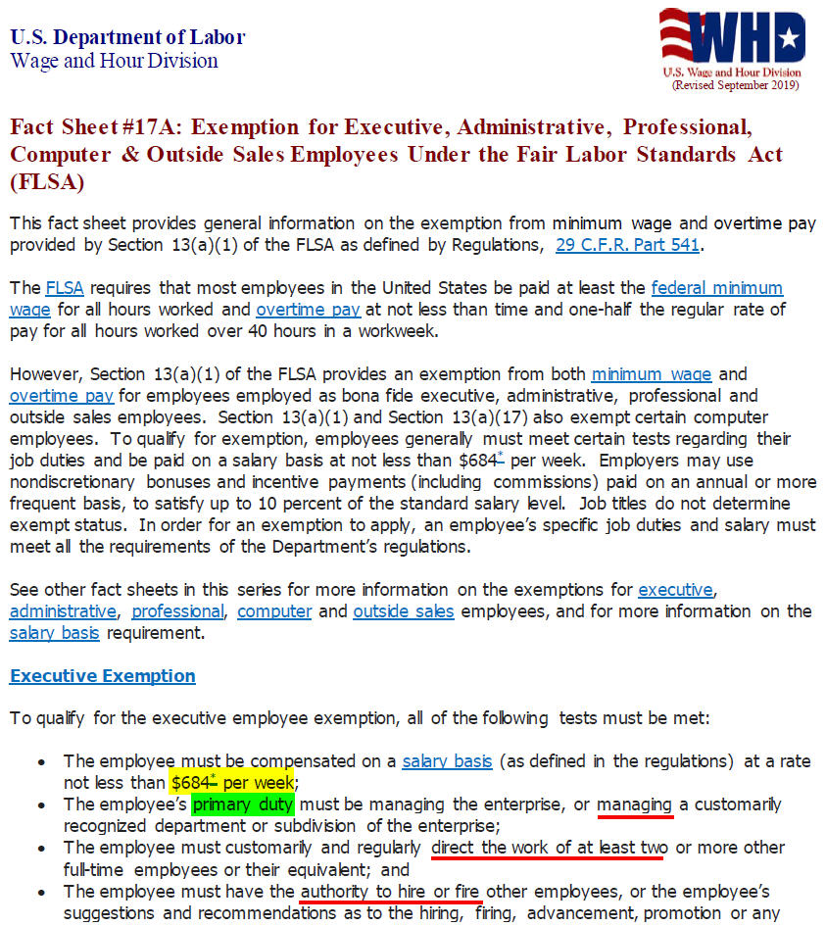

Slide 46
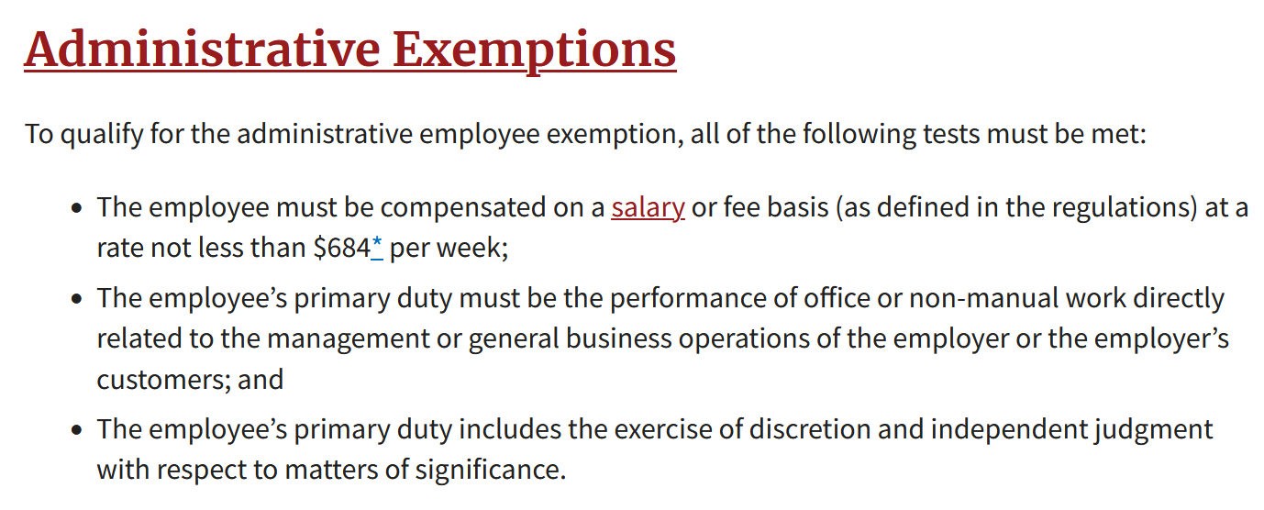

Slide 47
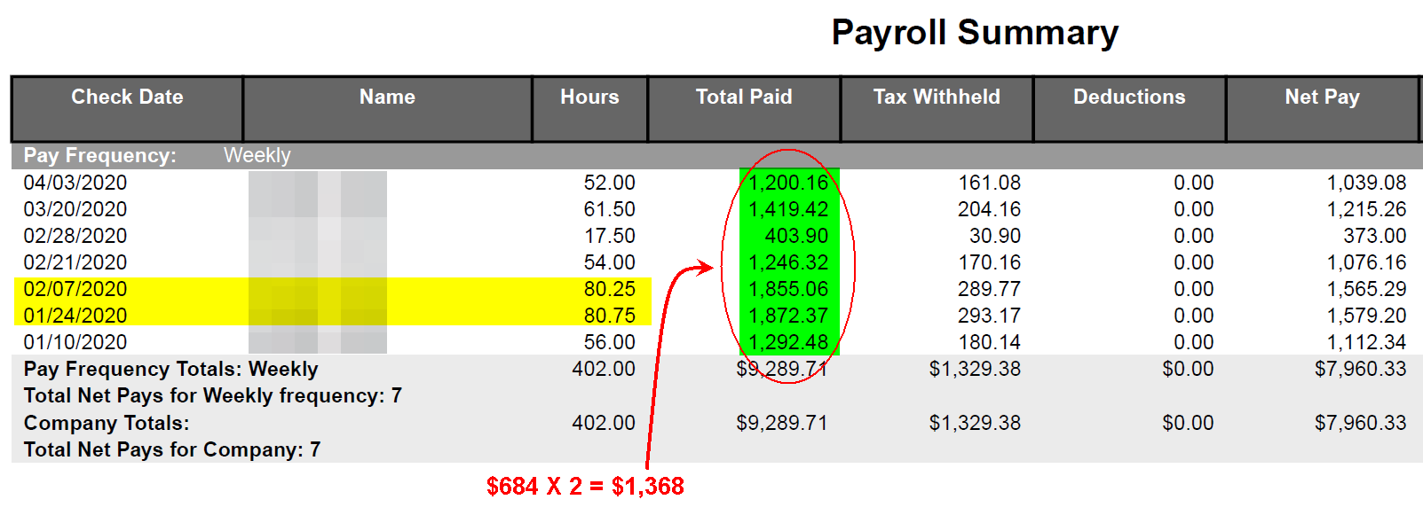

Slide 48


Slide 49


Slide 50
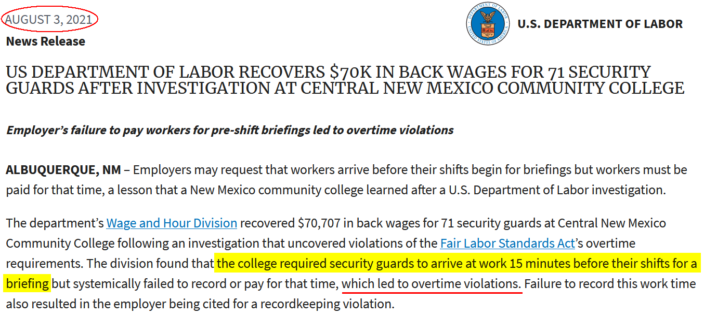

Slide 51
Is a non-profit allowed to pay an employee compensatory time off (comp time) in lieu of paying overtime in the paycheck?
_________ Yes
_________ No

Slide 52

Is a non-profit allowed to pay an employee compensatory time off (comp time) in lieu of paying overtime in the paycheck?
_________ Yes
_________ No

Slide 53
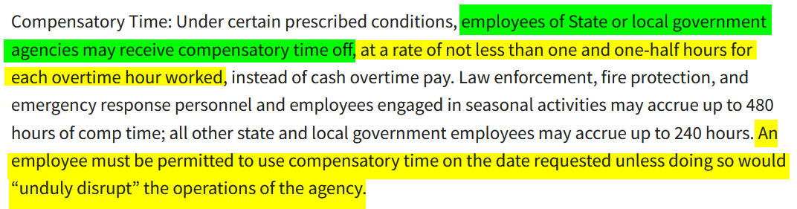

Slide 54
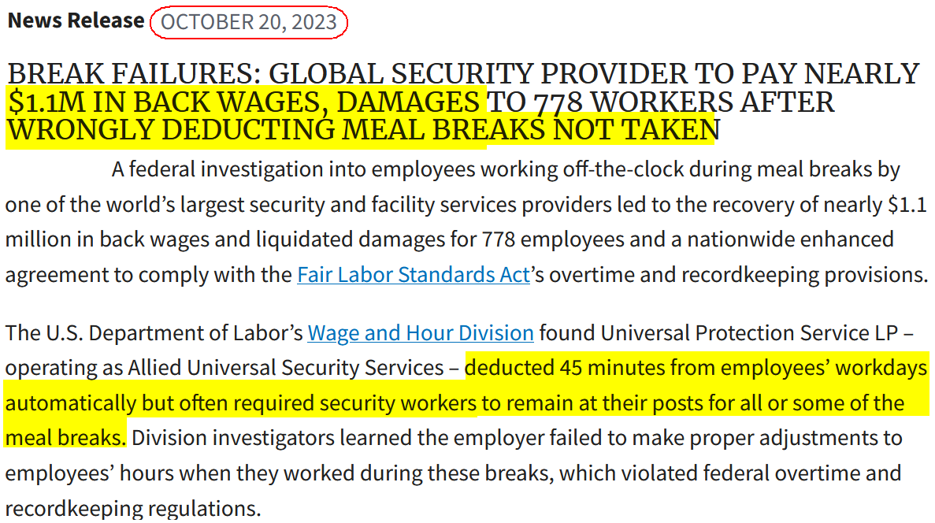

Slide 55

No

Slide 56
Must pay but can discipline

Slide 57
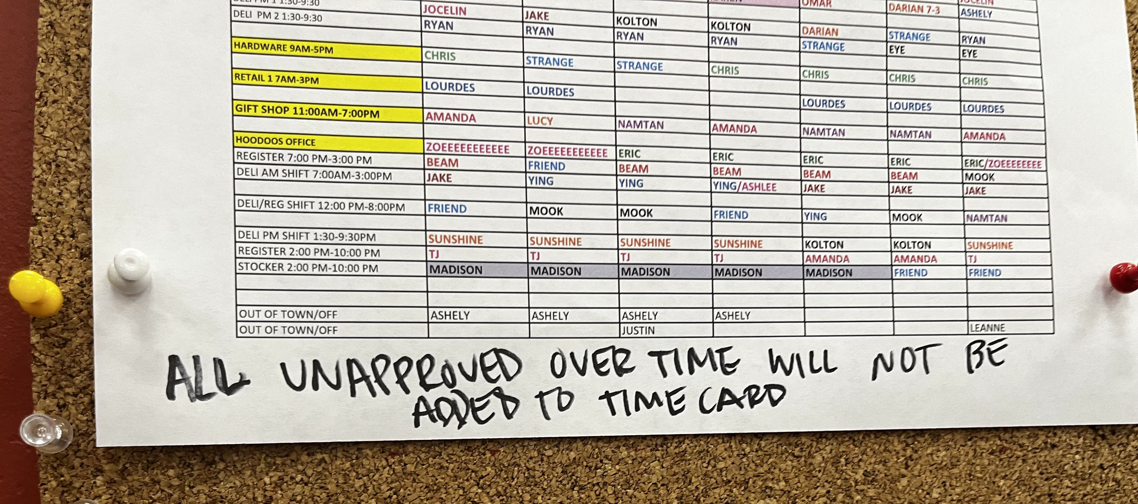

Slide 58
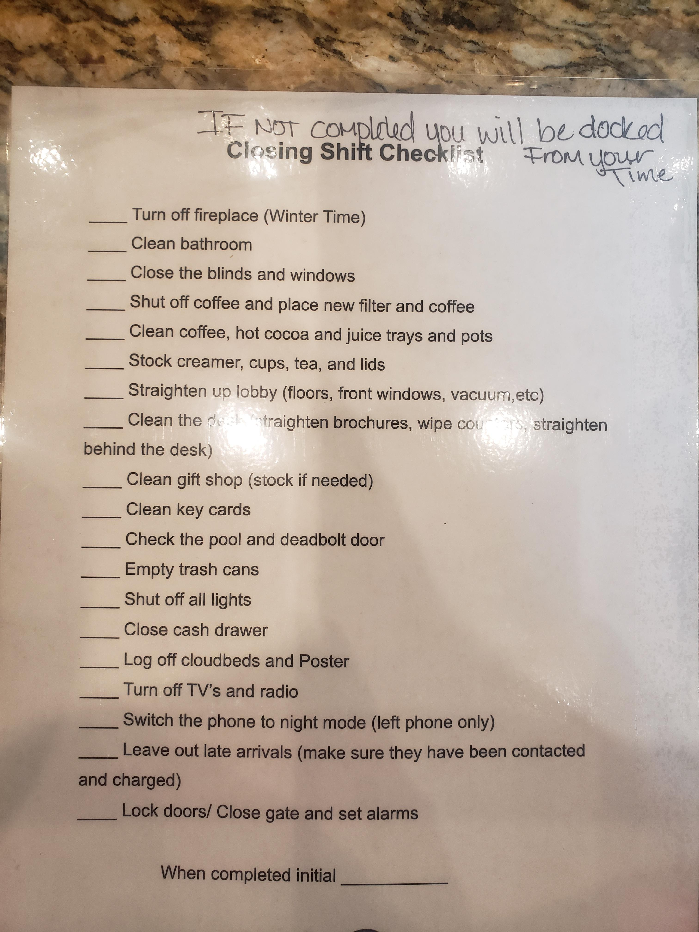

Slide 59
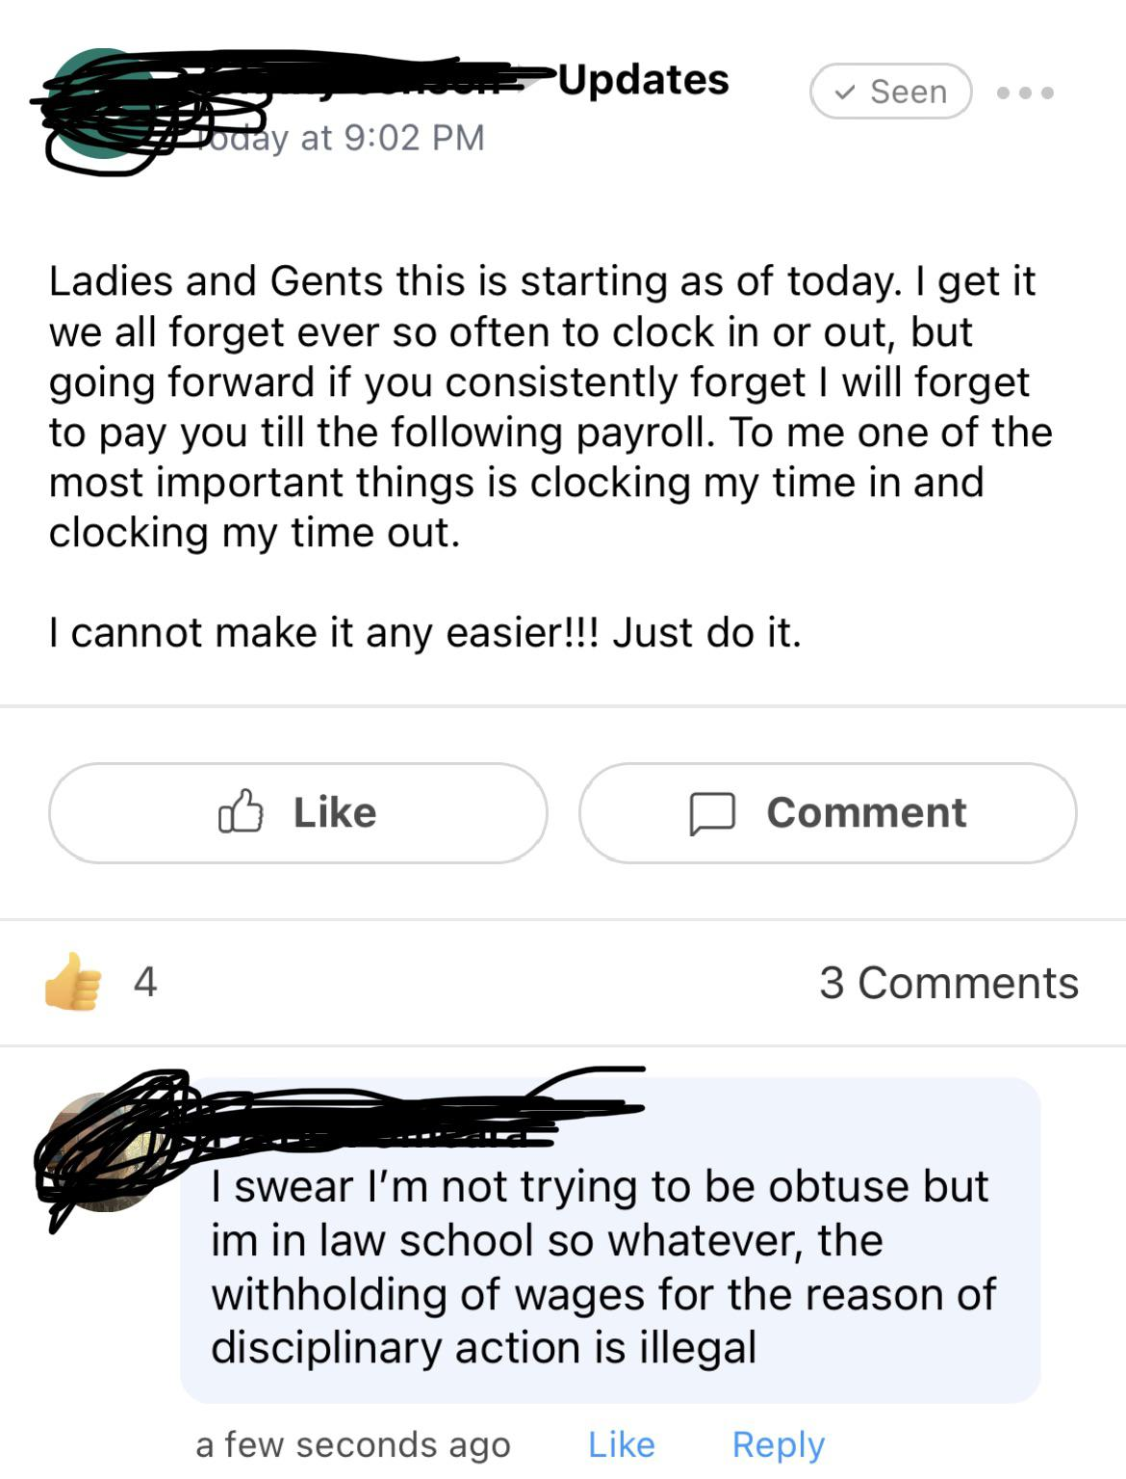

Slide 60
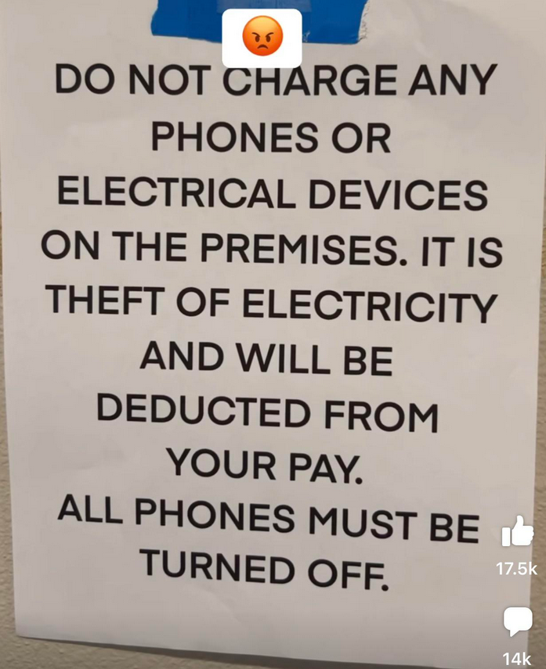

Slide 61
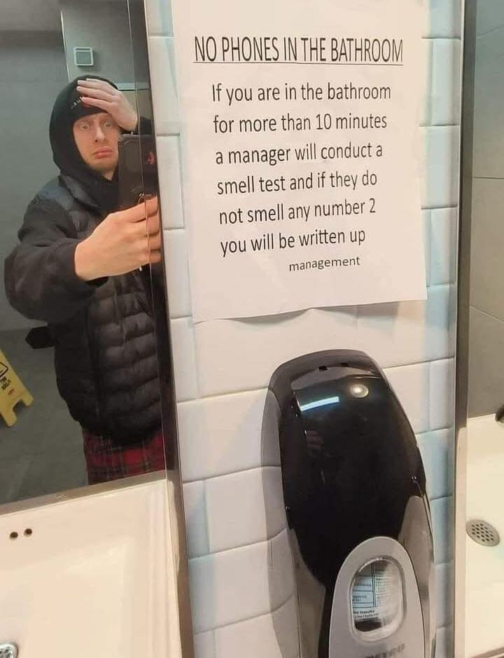

Slide 62
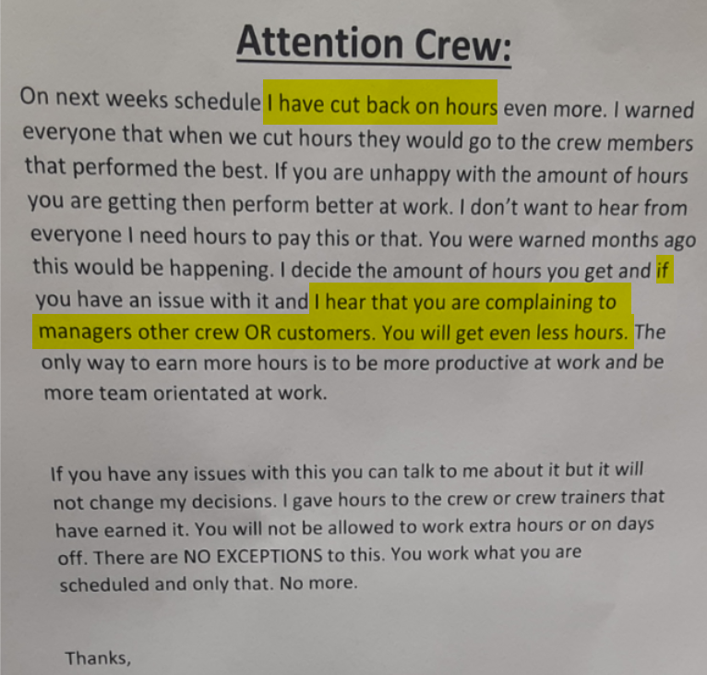

Slide 63
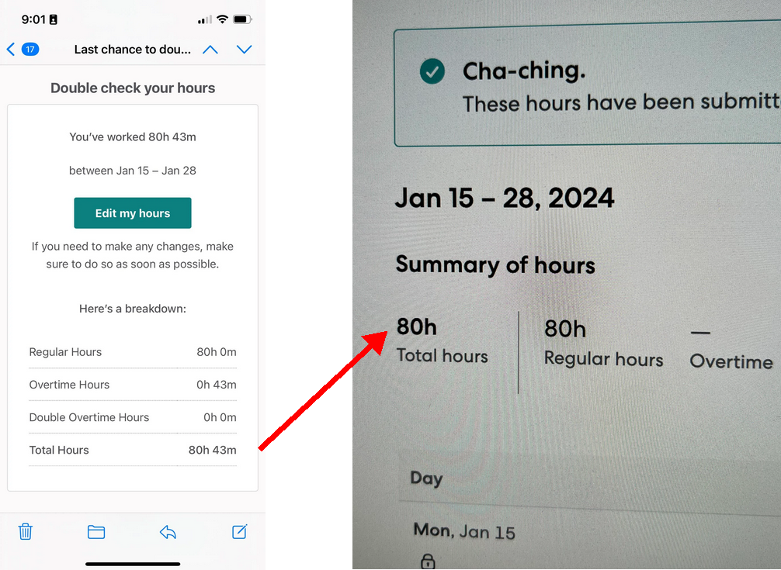

Slide 64
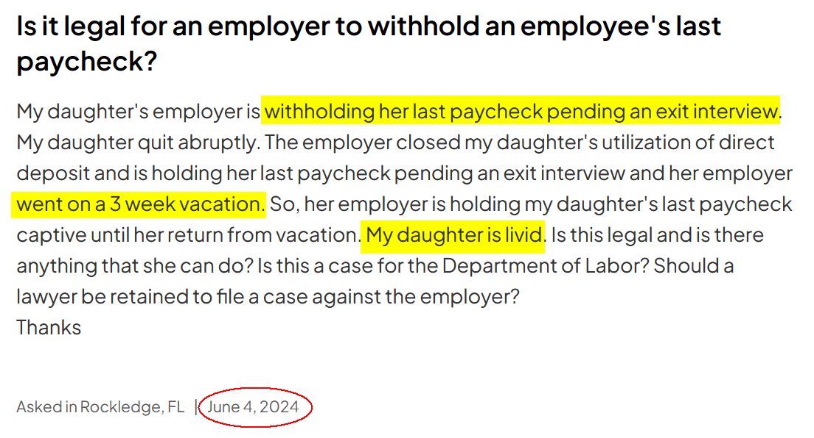

Slide 65
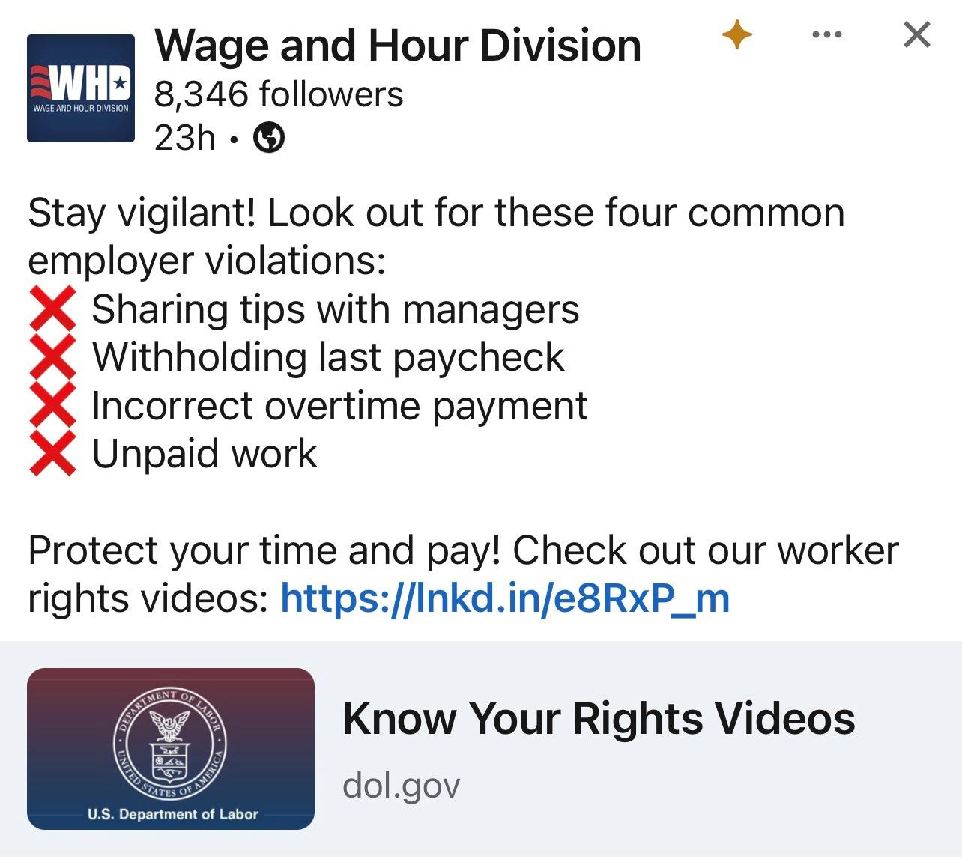

Slide 66
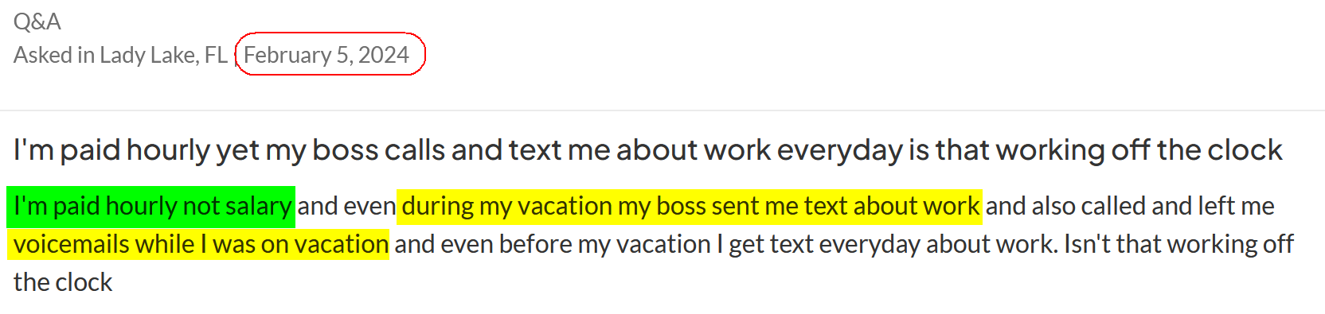

Slide 67
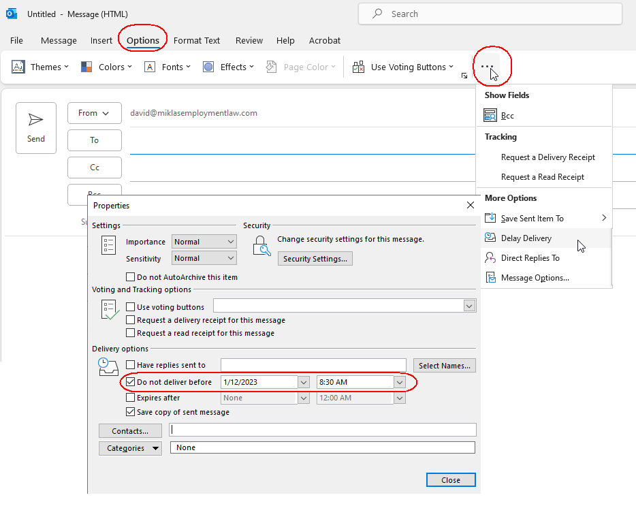

Slide 68


Slide 69


Slide 70


Slide 71

Unmet performance expectations are often due to unclear or uncommunicated expectations

Slide 72
Do they know it’s a performance expectation to come to work on time?
Do they know why?
You need: Clear performance expectations
What about behavioral expectations
More detail-oriented vs big picture

Slide 73

Receive feedback (monitoring and reviewing)
Ee abrupt/abrasive when speaking
Ask them, “what is your intention when speaking?” Passionate and persuasive

Slide 74
Why didn’t you do the report?
I didn’t know I was supposed to do it
I didn’t know how to (training or resources convo)
I knew I was supposed to but I am overwhelmed - strategic or leadership convo

Slide 75

Telling an employee “good job” is a good start, but not enough.
Purpose of feedback:
Encourage desired behavior.
Do they know what they need to do to get another “good job?”

Slide 76

“Erica, when you included the graphics it allowed me to better understand the numbers so I can make an informed decision.”
This is encouraging feedback. It is better than just “good job.”

Slide 77
Tell them what success look like.
Even if you say, “good job” every day, they don’t know when they went above and beyond.

Slide 78
How to give Corrective feedback:
WHAT, WHY (twice)
Identify what is not working (WHAT was undesired action)
and WHY was it undesired
Then tell WHAT is the desired action and WHY it is desired
You need to have that second part ready when you meet

Slide 79
WHAT, WHY (twice)
“When you turn in the report late, it backs up the whole department.”
“I am confident that you can reprioritize this.”
“Can you commit to turning in the report on time so Tina gets it in time to edit it?”

Slide 80
If coaching you can enhance by explaining how to make even better.
This is different than corrective
Ideally you do this before corrective feedback
After corrective feedback, follow up with coaching meeting. Follow up. Put on calendar (1-3 weeks)

Slide 81
Performance leadership:
Set expectations
Give performance feedback
“By the end of week you are expected to do these things…”

Slide 82
Structured conversations:
“I noticed that in the meeting today when Joe was talking, I noticed that you rolled your eyes. I’m concerned that if someone saw you do that, they’d be concerned about you as a leader.” (Frame so it’s meaningful to them)
“What’s going on?”

Slide 83
ID situation
Describe behavior
Explain the impact

Slide 84
“I think that we should do x, what do you think?”
^^ This will not be effective.
Rather, just ask the question and shut up.

Slide 85
“I want to fire Sally.”
What’s your goal? I want her to show up on time.
Why is this important? She’s missing our team meeting.
What options do we have? I’ve told her to be on time.
Did you write it down so she understands the impact?
Ask questions rather than telling - that is coaching

Slide 86
TGROW
Topic: What would you like to think/talk about?
Goal: What do you want to move forward on?
Reality: What made you realize that you need to do
something different?
Option: What could you do to move yourself one step
forward?
Will: What will you do next? (they choose) How?
When? With whom?
What do you need from me?

Slide 87
Inflated evaluations

Slide 88

Inflated Employee Appraisals

Slide 89


Slide 90


Slide 91


Slide 92

Eval says “exceeds expectations” rather than “outstanding?”

Slide 93


Slide 94


Slide 95


Slide 96
You always fire the behavior
NOT THE EMPLOYEE

Slide 97


Slide 98


Slide 99


Slide 100


Slide 101


Slide 102


Slide 103


Slide 104


Slide 105


Slide 106


Slide 107


Slide 108
Do not be unclear:
Do not say employee has a “bad attitude.”
Document specific behaviors and quote specific language.
Black employees can claim “tone policing” to portray a Black woman as being angry or aggressive.

Slide 109


Slide 110

Discipline for using phone while driving

Slide 111


Slide 112


Slide 113

What if employee has been drinking?

Slide 114


Slide 115


Slide 116


Slide 117


Slide 118


Slide 119


Slide 120


Slide 121


Slide 122


Slide 123


Slide 124
POLL:
Does HR have an opportunity to review discipline?

Slide 125


HR needs to monitor

Slide 126


Slide 127


Slide 128


Slide 129


Slide 130


Slide 131


Slide 132


Slide 133


Slide 134

www.hrflorida.org

Slide 135
The investigation found:
He routinely talked about his past sexual experiences
Told administrative assistants to look on applicants' Facebook pages to see if they were “hot” or not.
Called a woman back from maternity leave a “milk maid.”

Slide 136


Slide 137


Slide 138


Slide 139


Slide 140
It is critical for first line supervisors to know how to respond. This is particularly true if an employee has an allegation of harassment and they go to their first line supervisor.
If an employee reports the harassment and hears back, “that’s just Joe. That’s how he is,” this is not acceptable.
The first line supervisor needs to know what to do if they receive a complaint.

Slide 141
Supervisors as bystanders
See something – say something
Recognize and interrupt these incidences
Catch the stuff in the gray area.
Conduct that is beginning to percolate.
Generally unpleasant conduct.
Before it morphs into harassment.

Slide 142


Slide 143


Slide 144


Slide 145


Slide 146


Slide 147


Slide 148

What is the riskiest employment action an employer can take?

Slide 149


Slide 150


Slide 151
Refuse to give an employee a reason for termination

Slide 152


Slide 153


Slide 154
Telling employee terminated because wanted a change in culture

Slide 155


Slide 156


Slide 157


Slide 158


Slide 159


Slide 160


Slide 161


Slide 162


Slide 163


Slide 164


Slide 165


Slide 166


Slide 167


Slide 168


Slide 169


Slide 170


Slide 171


Slide 172


Slide 173
What is the #1 basis that employees file a charge of discrimination? (Poll)
___ A) Race
___ B) Sex
___ C) Disability
___ D) Retaliation

Slide 174
What is the #1 basis that employees file a charge of discrimination? (Poll)
___ A) Race
___ B) Sex
___ C) Disability
___ D) Retaliation

Slide 175


Slide 176


Slide 177



Slide 178



Slide 179


Slide 180
Duty of reasonable accommodation
Some laws require more than mere non-discrimination; they also impose an affirmative duty on the employer to accommodate certain conduct that it otherwise would not accept. The two most common examples of these are: (1) the duty to “reasonably accommodate” a disability under the Americans with Disabilities Act, and (2) the duty to accommodate certain conduct based on religious beliefs under Title VII of the Civil Rights Act of 1964; and 3) employees affected by pregnancy, childbirth, or related medical conditions.

Slide 181

Interactive Process

Slide 182


Slide 183
The interactive process
Generally, an employee has a duty to request an accommodation, which then triggers the employer’s obligation to enter into an interactive process to determine a reasonable accommodation

Slide 184


Slide 185


Slide 186


Slide 188


Slide 189


Slide 190


Slide 191


Slide 192
Confidentiality
An employer may not disclose to other employees the fact that an employee is receiving a reasonable accommodation unless there is a specific need to know by a supervisor or manager.

Slide 193
The EEOC has advised that an employer may respond to a request from an employee about why a co-worker is receiving “special” treatment “by emphasizing its policy of assisting any employee who encounters difficulties in the workplace. The employer may also find it helpful to point out that many of the workplace issues encountered by employees are personal, and that, in these circumstances, it is the employer’s policy to respect employee privacy.”

Slide 194


Slide 195


Slide 196


Slide 197


Slide 198


Slide 199


Slide 200


Slide 201


Slide 202


Slide 203


Slide 204


Slide 205


Slide 206


Slide 207


Slide 208


Slide 209


Slide 210

DOL / EEOC Webinar on August 22, 2023

Slide 211


Slide 212


Slide 213


Slide 214

What if employee gives you this?

Slide 215


Slide 216


Slide 217


Slide 218


Slide 219


Slide 220


Slide 221


Slide 222


Slide 223


Slide 224


Slide 226


Slide 227
Questions?
David Miklas
Law Office of David Miklas, P.A.
Representing Florida Employers Since 1998
www.MiklasEmploymentLaw.com
Email: david@miklasemploymentlaw.com
1-772-465-5111

